Slide 1

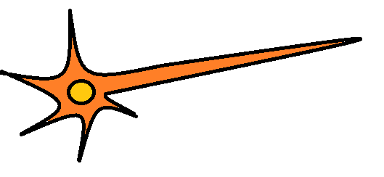
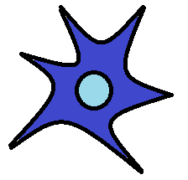
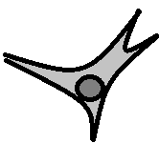
Brain Injury Promoting Neuroplasticity and Neurogenesis
Nicole L. Soiseth
Gustavus Adolphus College
Starring:
Progenitor Cell
Neuron
Astrocyte
Ogliodendrocyte

Slide 2
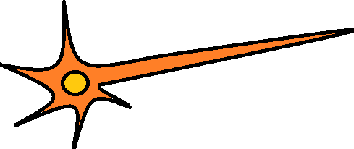
Blood Vessel
Normal Brain Tissue

Slide 3
Cytokines induce local inflammatory response
Injury
Cytokines Released Upon Injury
Injured Brain Tissue

Slide 4
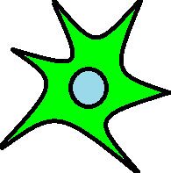
Injured Tissue
Boundary Astrocytes Become Reactive with Cytokine Activation
Injured Brain Tissue

Slide 5
Injured Tissue
Reactive Astrocytes Proliferate
Injured Brain Tissue

Slide 6
Injured Tissue
Proliferated Astrocytes form a barrier around the injured site called a Glial Scar.
Injured Brain Tissue

Slide 7
Injured Tissue
The Glial Scar blocks the further release of cytokines from the injured tissue
Injured Brain Tissue

Slide 8
Injured Tissue
Lets take a closer Look at the events occuring at the Glial Scar…
Reactive Astrocytes attract Progenitor cells to the Glial Scar
Injured Brain Tissue

Slide 9
Blood Vessel
Injured Tissue
Astrocytes emit Neurite Inhibitors to keep the progenitor cells undifferentiated until the correct conditions are met

Slide 10
Blood Vessel
Injured Tissue
Astrocytes increase the amount of nourishment to injured tissues to create an enriched environment known as the ‘Neurogenic Niche.’

Slide 11
Injured Tissue
EGF
FGF-2
FGF-2
EGF
FGF-2
EGF
EGF
FGF-2
EGF
At injury, Astrocytes emit Neurotrophic Factors to promote fate determination of neighboring cells

Slide 12
GFAP+
GFAP+
GFAP+
Injured Tissue
GFAP+
GFAP+
GFAP+
GFAP+
MAP2ab+
MAP2ab+
MAP2ab+
MAP2ab+
MAP2ab+
MAP2ab+
GalC+
GalC+
GalC+
Different Combinations of Neurotrophic Factors promote the expression of Cell Surface Markers
GalC+
GalC+

Slide 13
GFAP+
GFAP+
GFAP+
Injured Tissue
GFAP+
GFAP+
GFAP+
GFAP+
MAP2ab+
MAP2ab+
MAP2ab+
MAP2ab+
MAP2ab+
MAP2ab+
MAP2ab+
MAP2ab+
MAP2ab+
MAP2ab+
MAP2ab+
GalC+
GalC+
GalC+
Reactive Astrocytes can de-differentiate their fate by expressing Cell Surface Markers as well.
GalC+
GalC+

Slide 14
GFAP+
GFAP+
GFAP+
Injured Tissue
GFAP+
GFAP+
GFAP+
GFAP+
MAP2ab+
MAP2ab+
MAP2ab+
MAP2ab+
MAP2ab+
MAP2ab+
MAP2ab+
MAP2ab+
MAP2ab+
MAP2ab+
MAP2ab+
GalC+
The cells continue to develop and mature into Astrocytes, Neurons, and Ogliodendrocytes using the nutrient rich ‘neurogenic niche’.
GalC+
GalC+
GalC+
GalC+

Slide 15
GFAP+
GFAP+
GFAP+
Injured Tissue
GFAP+
GFAP+
GFAP+
GFAP+
MAP2ab+
Glutamate
MAP2ab+
MAP2ab+
Glutamate
Glutamate
MAP2ab+
MAP2ab+
MAP2ab+
MAP2ab+
MAP2ab+
MAP2ab+
GABA
MAP2ab+
GABA
GalC+
MAP2ab+
GalC+
If new neurons are stimulated by existing neurons, they become wired into existing circuits
GalC+
GalC+
GalC+

Slide 16
GFAP+
GFAP+
GFAP+
Injured Tissue
GFAP+
GFAP+
GFAP+
GFAP+
MAP2ab+
MAP2ab+
MAP2ab+
MAP2ab+
MAP2ab+
MAP2ab+
GalC+
GalC+
If new neurons are NOT stimulated, then they undergo programmed cell death (Apoptosis)
GalC+
GalC+
GalC+

Slide 17
GFAP+
GFAP+
GFAP+
Injured Tissue
GFAP+
GFAP+
GFAP+
GFAP+
MAP2ab+
MAP2ab+
MAP2ab+
MAP2ab+
MAP2ab+
MAP2ab+
GalC+
The Injured site slowly regains function with stimulation in neighboring neuron circuits and cortical re-mapping.
GalC+
GalC+
GalC+
GalC+

Slide 18
GFAP+
GFAP+
GFAP+
GFAP+
GFAP+
GFAP+
GFAP+
MAP2ab+
MAP2ab+
MAP2ab+
MAP2ab+
MAP2ab+
MAP2ab+
GalC+
Reactive Astrocytes return to their Quiescent state until they are activated once again.
GalC+
GalC+
GalC+
GalC+

Slide 19
Blood Vessel
The brain tissue may never function the same after an injury, but it attempts to return to a Normal state.

Slide 20
The End!

